Slide 1
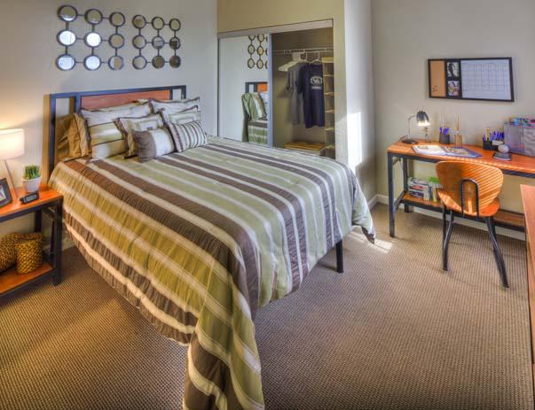
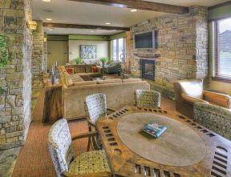
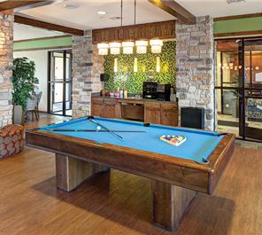
Villas at Chestnut Ridge
Victoria Anderson, John Rein, Arielle Syposs,
Joanne Chen, Ruihan Ding

Slide 2
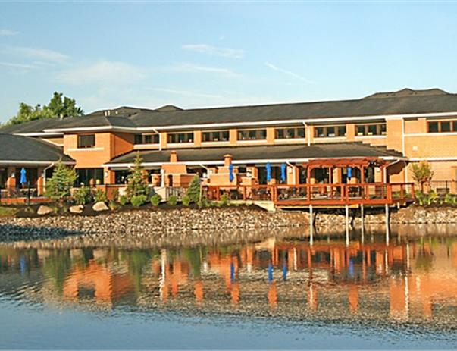
Agenda
Villas background
Old file keeping process
Proposed new file keeping process
Database Trial
Backup Strategy
Future Enhancements
Conclusion

Slide 3
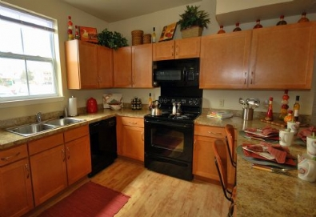
Company Background
Villas at Chestnut Ridge (VCR) is an American Campus community built in 2007
Conveniently located within walking distance, and provides shuttle transportation to and from UB
Takes pride in the upkeep of the apartments
Work order services for when appliances break down, all students have to fill out a work order online or at the front desk

Slide 4
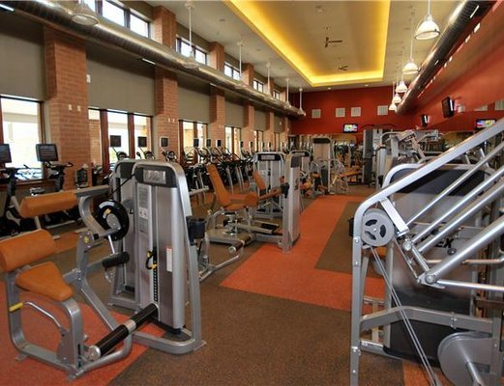
My Role in the Company
Community Assistant for the Villas at Chestnut Ridge
Leasing duties - new leases, new applicants, current applicants
Front desk accommodations – residents can place work orders, pay rent, ask any questions they may have
On call for any emergencies

Slide 5
Old File Keeping System
Currently uses a paper trail within files to show communication with residents
Microsoft Excel is used to show a spreadsheet with contact information of current residents and their Guarantor
Uses a program called LAMS to input information for current residents, applicants, and also students interested in the property
Use another software program called MRI, which is used to track residents balances and work orders

Slide 6
Pictures of Old File Keeping System

Slide 7
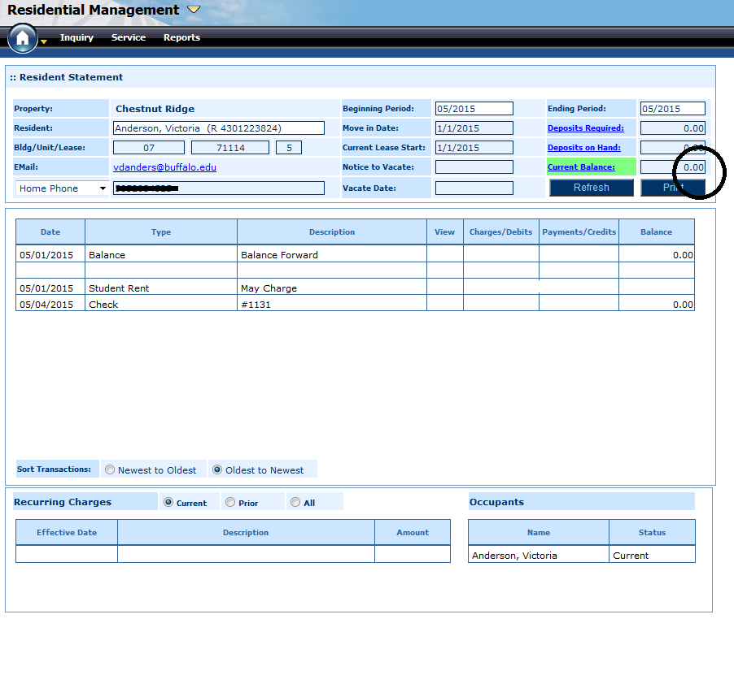
Pictures of Old File Keeping System
Account Balances
Work Order Submission

Slide 8
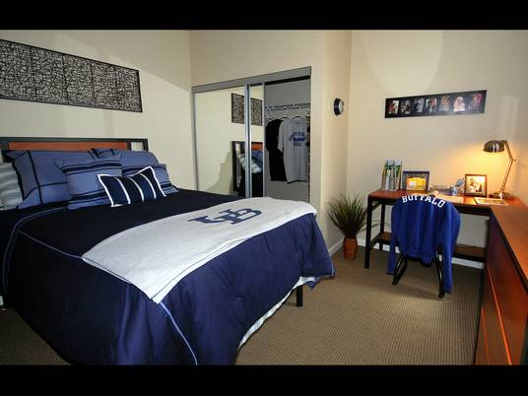
New File Keeping System
Proposed database will allow for time efficiency along with cost savings
Make it easier for employees because they only have to open 1 system
Work orders & current residents information / statements
Access resident’s statements, applicants (LAMS) and work orders (MRI)
Combining both systems will reduce the staff needed ultimately reducing the budget
Faster to assign the work order from the resident to the maintenance staff
Clarity of access will prevent issues with work orders not being fulfilled
Ability to adjust future need with windows access system

Slide 9
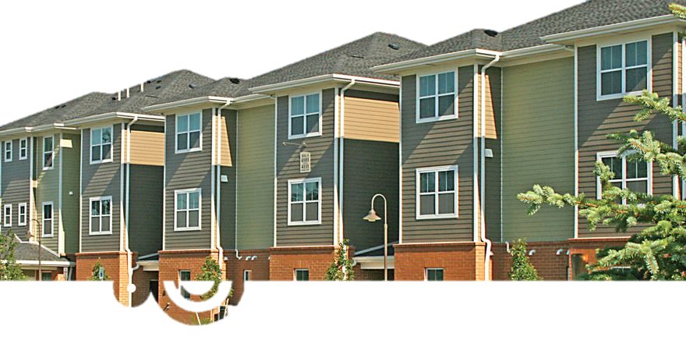
Our Database

Slide 10
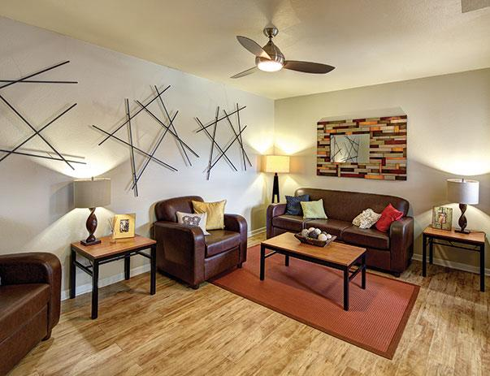
Backup Strategy
Database will be backed up to cloud on a weekly basis
Every Friday before management leaves
Ensures that all work orders (completed & in progress) are backed up for the following weeks completion
Applicants and current residents sign a 1 year lease with the property
August to August leases
Each year we will update the database based on new residents or residents who are planning on renewing (living with us again the following year) to ensure accuracy

Slide 11
Future Enhancements
Bigger & better organization system in case the company expands and buys new properties
Entering data for new applicants
If they want to pay in advance before they move in

Slide 12
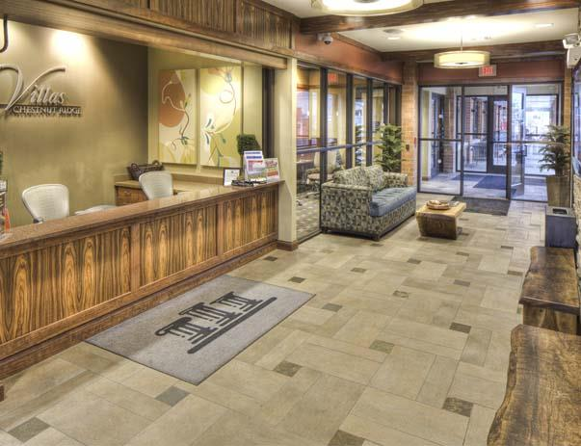
Conclusion
Combined two data keeping systems (LAMS and MRI) using access database
Reduce the extra cost for staff
More time efficient and easily understood by staff

Slide 13
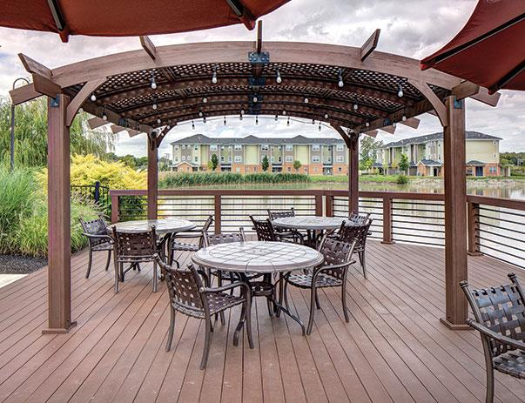
Questions?

